Slide 1
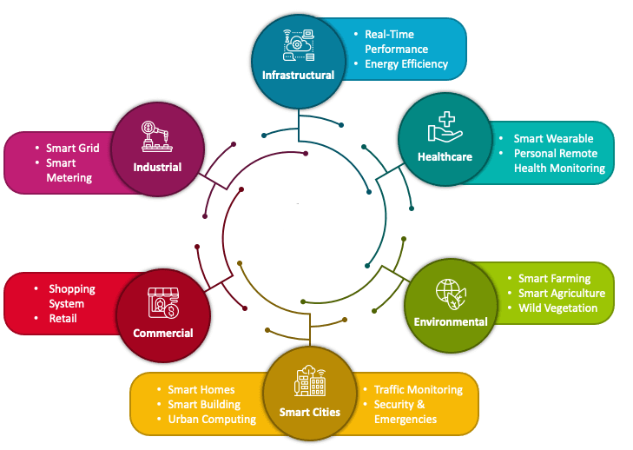

Service Discovery Protocol for the IoT Ecosystem
PDS
Notes:
https://www.vturesource.com/vtu-syllabus/CS/2018/8/18CS81
AWS : IoT Device Simulator https://aws.amazon.com/solutions/implementations/iot-device-simulator/?did=sl_card&trk=sl_card
https://aws.amazon.com/s3/
https://www.vturesource.com/vtu-syllabus/CS/2018/8/18CS81
https://www.simplilearn.com/pgp-full-stack-web-development-certification-training-course?utm_campaign=Skillup-IOT-6mBO2vqLv38&utm_medium=Comments&utm_source=youtube

Slide 2
Internet of Things
Infrastructure Protocols
Protocol architecture of IoT
Security
Apps
Notes:
Service Discovery Protocol for the IoT Ecosystem

Slide 3
Infrastructure Protocols
Notes:
https://hsng.csie.io/courses/2020/IoT/ppt/course2/(1117)-IoT_IP.pdf
http://www.tigli.fr/lib/exe/fetch.php?media=cours:2016_2017_mit_mqtt_lecture_2_.pdf
https://drait.edu.in/assets/departments/ECE/materials/Internet_of_things.pdf

Slide 4
Protocol Architecture of IoT
Routing Protocol
RPL stands for routing protocol for low power and lossy networks. It is an IPv6 protocol. Low- power lossy networks include wireless personal area networks (WPANs), low-power line com- munication (PLC) networks, and wireless sensor networks (WSNs). ese networks have some characteristics:
◾ Capability to optimize and save energy
◾ Capability to support tra c patterns other than unicast communication
◾ Capability to run routing protocols over link layers with restricted frame siz

Slide 5
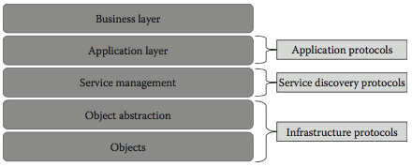
Protocol architecture of IoT

Slide 6
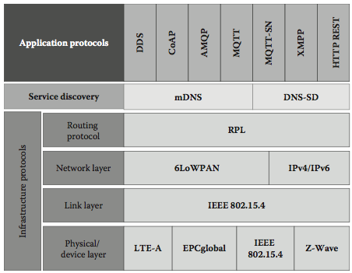
Categorization of IoT protocols

Slide 7
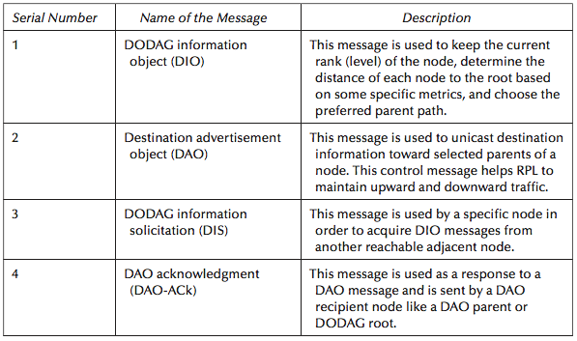
DODAG control messages

Slide 8
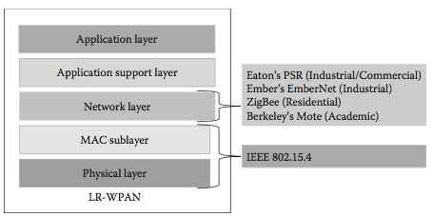
Architecture of IEEE 802.15.4.

Slide 9
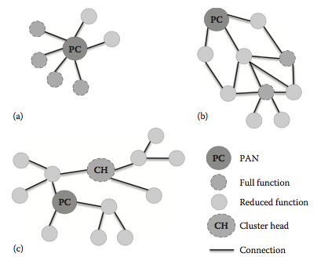
(a–c) Different types of star topologies

Slide 10
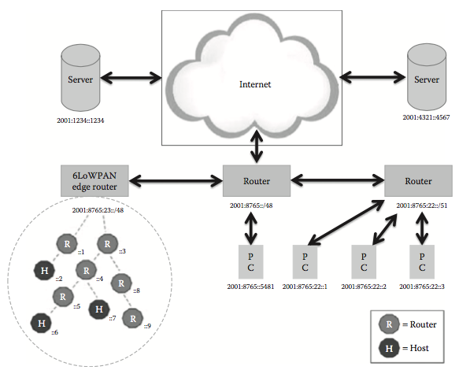
Network architecture of 6LoWPAN

Slide 11
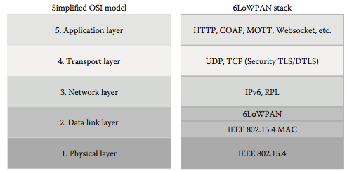
Protocol stack of 6LoWPAN

Slide 12
Bluetooth Low Energy
Bluetooth low energy (BLE) was started as part of the Bluetooth 4.0 core speci cation.
BLE uses short-range radio with minimum power and operates for a long time.
Physical layer: is layer receives and transmits data bits. Link layer: Following are the functions performed by the link layer:
– Media access control – Error control – Connection establishment – Flow control

Slide 13
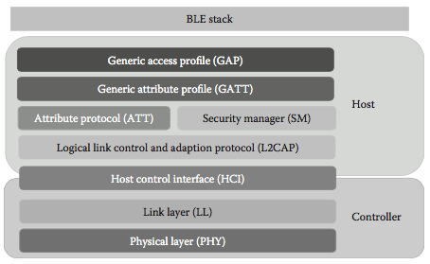
Protocol stack of BLE

Slide 14
Long Term Evolution-Advanced
Long term evolution-advanced (LTE) also referred to as 4G LTE is a standard for wireless mobile network, and it provides high speed data transfer rates for wireless networks.
It will provide 50 times performance improvement for existing wireless networks.
LTE broadcast is a single- frequency network (SFN) that operates in a broadcast mode.

Slide 15
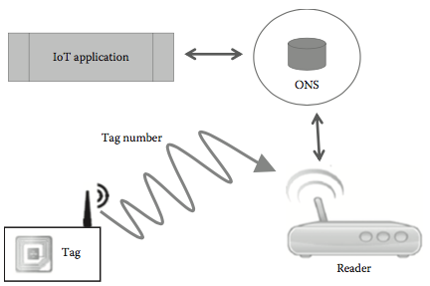
Components of RFID system.

Slide 16
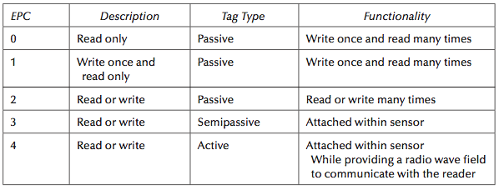
Different Types of EPC Tags

Slide 17
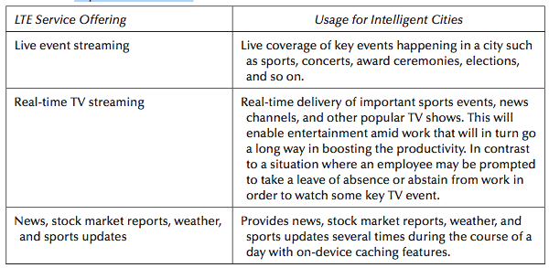
Key Use Cases of LTE

Slide 18
ZigBee
ZigBee protocol was framed by the ZigBee alliance. Following features of ZigBee make it very suitable for IoT applications:
◾ Lowpowerconsumption
◾ Lowcost
◾ Support for large number of network nodes (<=65K nodes)

Slide 19
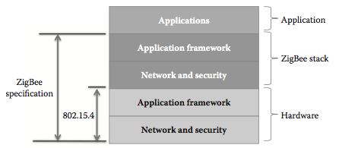
Protocol architecture of ZigBee.

Slide 20
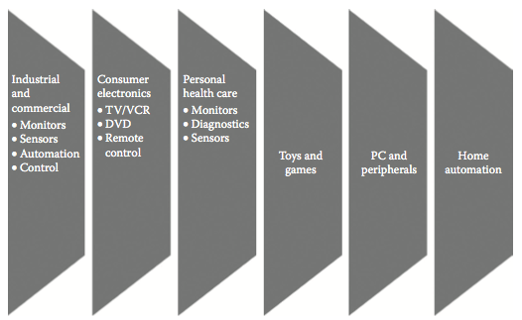
Main application areas of ZigBee

Slide 21
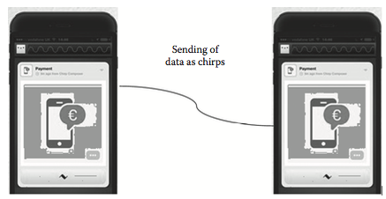
Working of chirp.
^{How Chirp Works}
◾ Chirp contains a short string of data, which has been encoded using alphabets of electronic birdsong that includes 32 semitone pitches.
◾ Encoding and decoding of data are done locally by each mobile device, and hence it is not necessary to have an Internet connection for basic exchange. What is required is just a speaker to send data and a microphone to receive data.
◾ Instead of splitting huge amounts of data into chirps, there exists an option for the device to upload les to a cloud server and then tweet out a URL that will contain chirps.
◾ Chirps are highly reliable over short distances in locations that are quiet without much of background noise

Slide 22
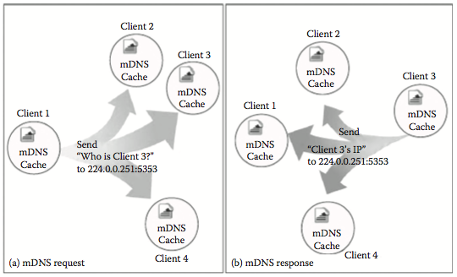
Working of multicast domain name system (mDNS)

Slide 23
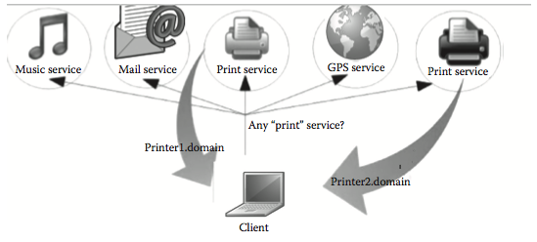
Service discovery of a printer service using DNS-SD protocol.

Slide 24
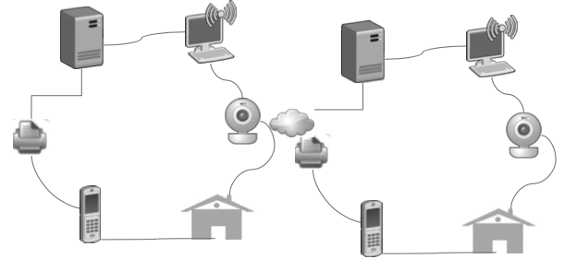
Working of UPnP.
Universal Plug and Play (UPnP) is a collection of networking protocols that was devised by UPnP forum.

Slide 25
The three basic components of a UPnP network are the following:
◾ Devices ◾ Services ◾ Controlpoints
– Device: It is a container for services and other nested devices, which are part of the network. A service basically is the most granular unit of control that o ers a set of actions.
– Control points: is provides the feature of device discovery and control by receiving device and service descriptions and by invoking service actions.
– Services: e set of services that are o ered by UPnP devices.

Slide 26
Service Discovery Protocol for the IoT Ecosystem
Semua Bahan mengacu kepada buku : The Internet of Things: Enabling Technologies, Platforms, and Use Cases [Pethuru Raj, Anupama C. Raman]

Slide 27
Thank You

